Slide 1


IVRS
An Initiative of
Controller of Communication Accounts
Gujarat
21 August 2025
National Senior Citizens Day

Slide 2
What is IVRS ?
IVRS is "Interactive Voice Response System".
It is a telephone-based system where you call a number and a recorded voice guides you step-by-step.
This service is started by CCA Gujarat on toll free no. 1800-233-0365.

Slide 3
Why an IVRS for Pensioners?
Instant information without visiting the office
Available 24×7
Available in three languages
No call charges
01
02
03
04
After Bank & Post Office migration, CCA Gujarat has 31000 pensioners in SAMPANN.
IVRS will help to provide prompt resolutions to recurring grievances and inquiries of pensioners.

Slide 4

Let us understand the flow

Slide 5


Dial the toll free number: 1800- 233- 0365
Choose your language:
  Press 1 for Gujarati
  Press 2 for English
  Press 3 for Hindi

Slide 6
Select the required option from the main menu
Press 1
Press 2
1
2
Know your NEW PPO Number
Update your Mobile Number.
3
4
Press 3
Press 4
Know your Life Certificate Validity
Connect to
our official

Slide 7
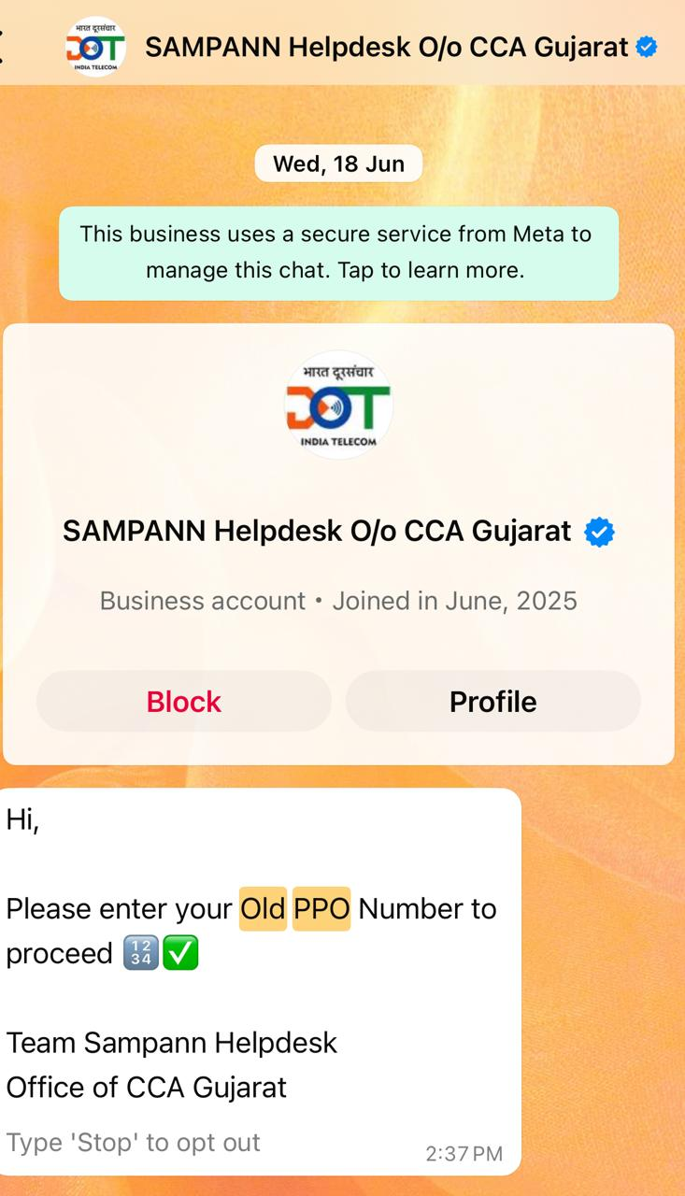
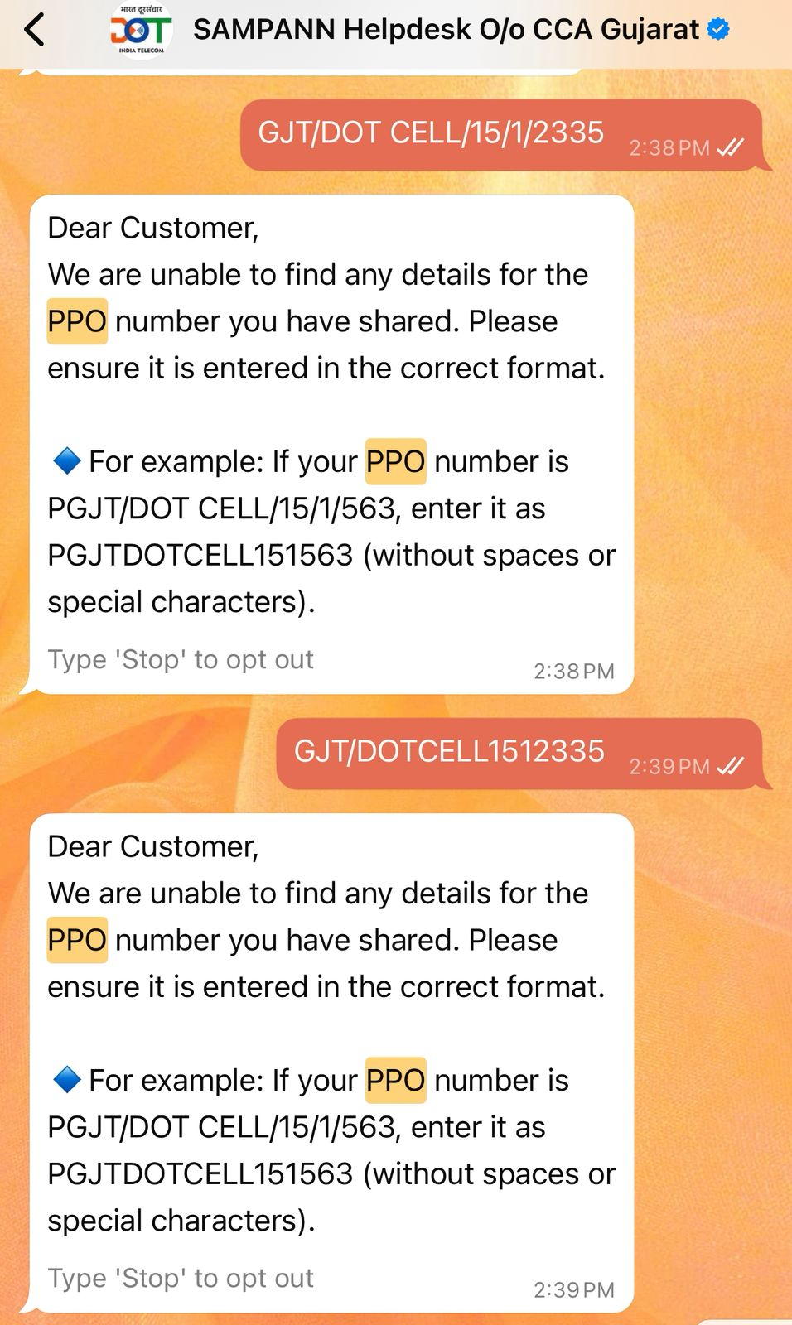
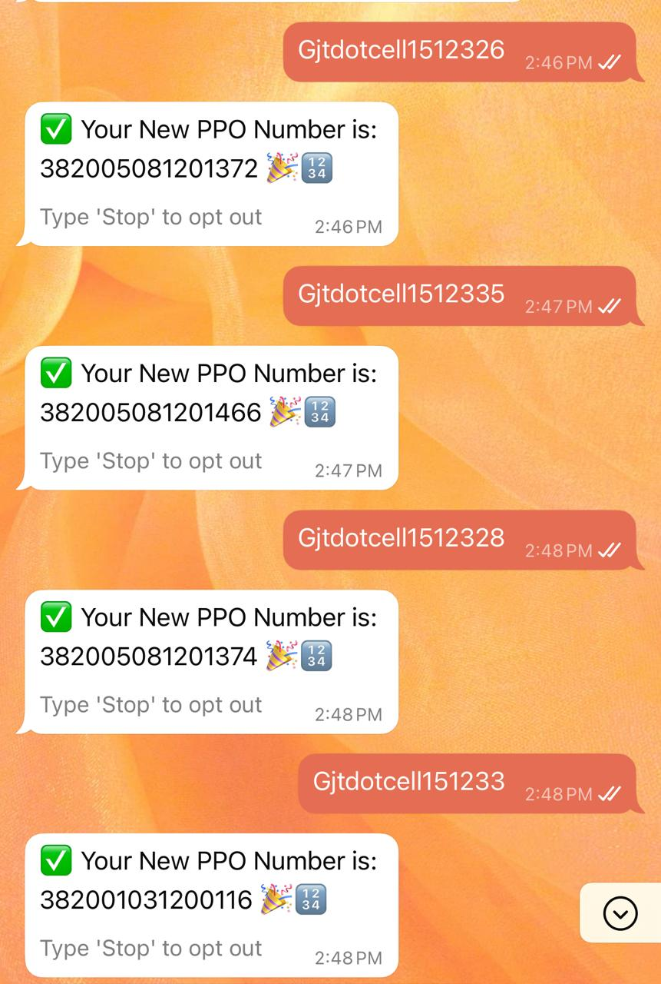
Press 1 Know your NEW PPO Number
You will receive a WhatsApp message from the CCA Gujarat helpline

Slide 8
Press 2 - To update your Mobile Number
2 Options
Press 1 - if you have new PPO number
Press 2 - if you have OLD PPO number
Press 1
Please enter your 15 digit New PPO number
15 digit PPO number entered, your registered mobile number is XXX
Press 1 to update your number
Press 0 to return to main menu
Press 1- please enter your 10 digit new mobile number
Enter 10 digit New Mobile number
Your request has been submitted Successfully
or
Your request is under process

Slide 9
Press 3 - To know your Life Certificate Validity
2 Options
Press 1 - if you have new PPO number
Press 2 - if you have OLD PPO number
Press 1
Please enter your 15 digit New PPO number
15 digit PPO number entered, Your Life certificate is valid upto
XXXXX
For Life Certificate expired,
Your Life Certificate has already expired. Please update your Life Certificate immediately for uninterrupted disbursement of pension.
For LC expiring in the current month
Your Life Certificate is expiring in this month, with expiry date being (date). Please update your Life Certificate before 15th of the next month for uninterrupted disbursement of pension.

Slide 10
Press 4 - To connect to our Official
You will be connected to a helpdesk representative (during office hours in working days)
Line Connected, official can guide you on pension related queries
If line is busy, please await your turn

Slide 11

IVRS Benefits
Friendly & Accessible
Simple number choices; no complex inputs required
Multilingual support
English,Hindi,Gujarati
Available 24×7;
works from any phone

Slide 12
Pensioner Samvaad
21 August 2025
National Senior Citizens Day

Slide 13
Pensioner Samvaad -
A New Initiative by CCA Gujarat
Purpose:
A platform for direct interaction of pensioners with CCA /
Jt. CCA/ Dy. CCA
Share issues related to pension cases or give suggestions for improving pension related services.

Slide 14
Pensioner Samvaad
Schedule:
2nd & 4th Wednesday of each month.
Time: 11:00 am to 12:00 noon.
Venue : 6th Floor, O/o CCA, Khanpur, Ahmedabad.
Participation Options:
1. In-person: Walk in to CCA Office, during the scheduled time.
2. Online: Join via meeting link (will be shared through WhatsApp).

Slide 15
Pensioner Samvaad
How to Join Online:
Send a WhatsApp message to 94298 92784 saying “I want to join Pensioner Samvaad”.
Meeting link will be sent to you before the session.
Who Will Join from CCA Office:
CCA / Jt. CCA / Dy. CCA
Officers dealing with Pension

Slide 16
Pensioner Samvaad
Benefits:
Direct communication with higher authorities.
Quick redressal of pension-related issues.
Opportunity to give feedback for improvement of services.

Slide 17
Quick Reference- CCA Gujarat Helpline
Toll Free No.
1800-233-0365
Whatsapp Helpline
94298 92784
Landline No.
079-25510050
Email address-
ccapension.gj@gmail.com
pda.ccagj-dot@nic.in

Slide 18
THANK YOU

